Slide 1


Data Analysis
Performance Dashboard
US superstore

Slide 2
Data Analysis
Data Analysis is the science of cleaning, changing, and processing raw data, and extracting actionable, relevant information that helps businesses make informed decisions.
Follows knowledge Discovery Process
Business understanding ( Identify Project objective)
Data understanding ( Collect and review data)
Data Preparation (Select and clean data)
Modeling (Manipulate data and draw conclusions)
Evaluation (Evaluate model and conclusions)
Deployment (Apply conclusions to business)

Slide 3
Scope of analysis
Sales, Quantity and Profit of each product category
Segment Distribution of each product category
Sales and Profit throughout months of a sales of each product category
Regional Sales of each product category
Overall Sales Trend throughout months of a sales year
Distribution of Order Priority
Customer Ordering Trend
Analysis of work Performance of Regional Managers
Comparison of sales and profit product category wise
Analyzing Shipping priority share.

Slide 4
Steps to be performed…………..
Step 1: Removing the blank cells from the dataset.
1
Step 2: Removing columns which are not properly defined or not crucial to our analysis.
2
Step 3: Giving proper and appropriate column names.
3
Step 4: Excluding the NULL values from the data.
4
Step 5: Improvising Proper Data Formatting
5
Step 6: Removing Duplicate Values
6

Slide 5
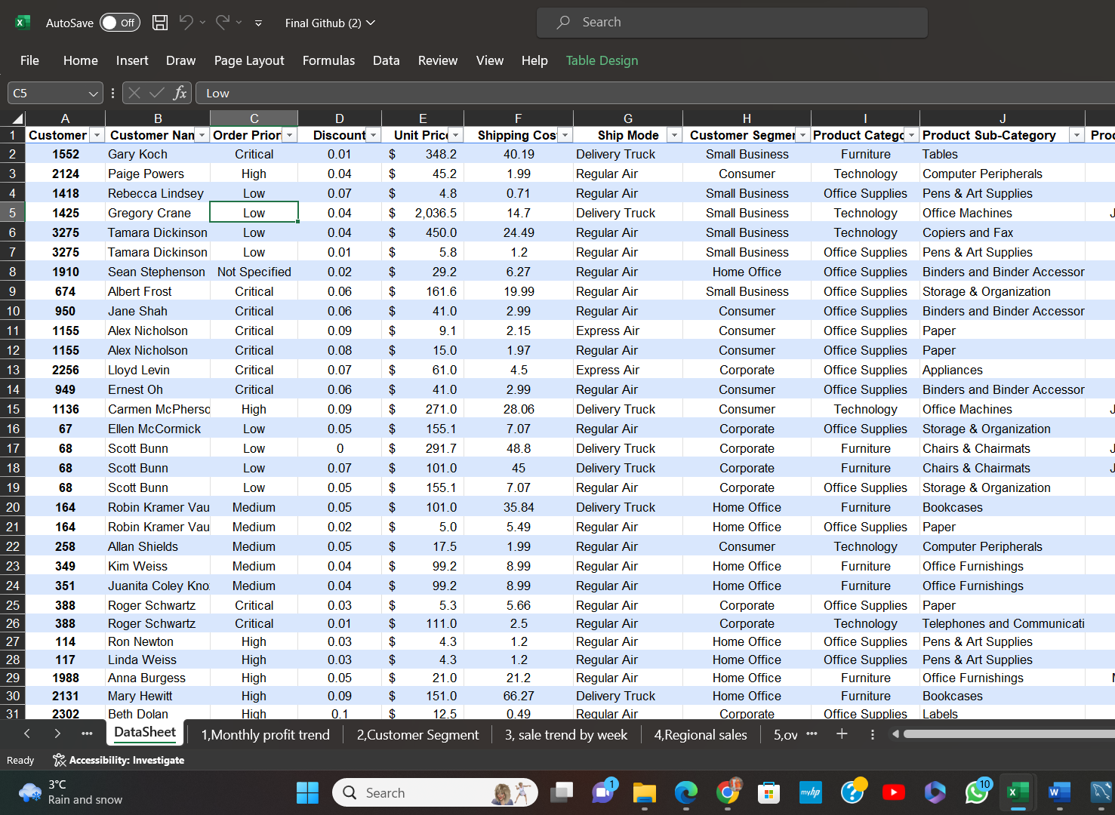
Make raw data into tabular form
After Cleaning process, tabular form is created.
Click anywhere in datasheet.
Select Insert and click on Pivot table

Slide 6


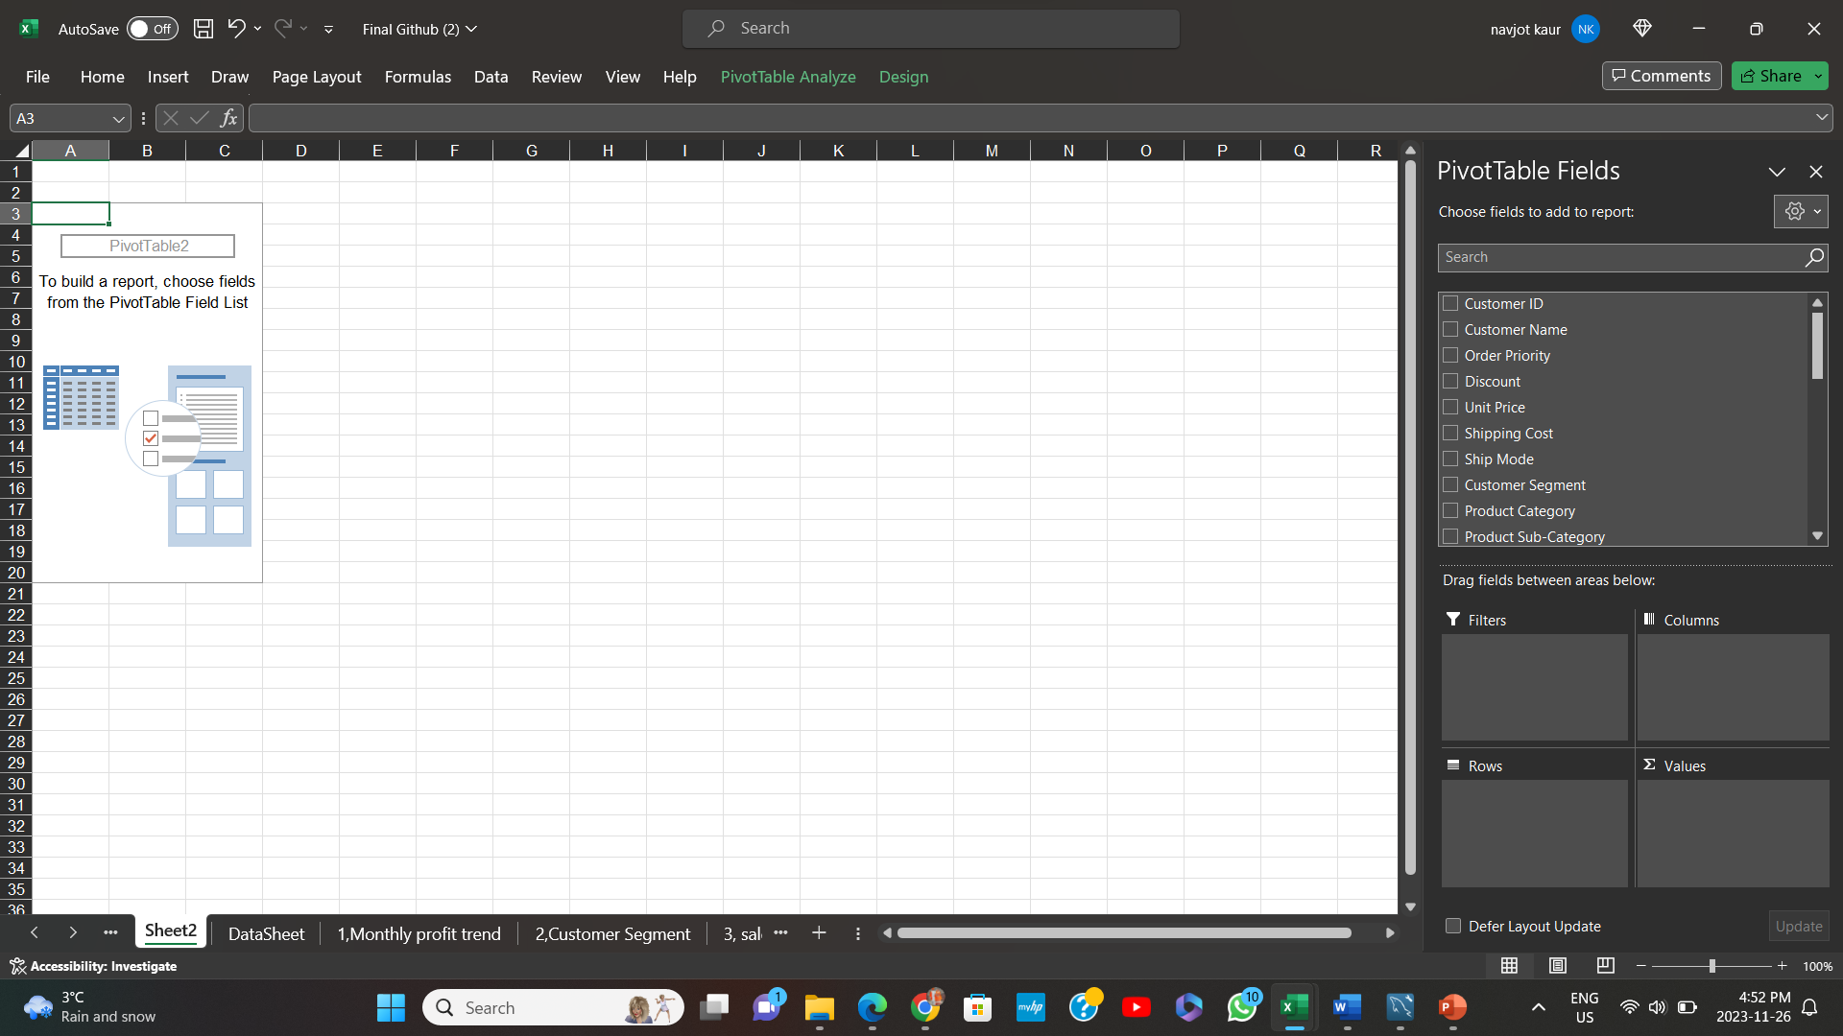
How to Insert Pivot table
Click anywhere in datasheet.
Select Insert and click on Pivot table

Slide 7
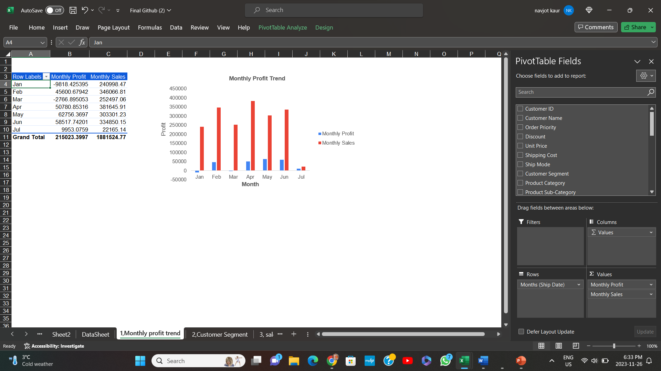
Monthly Sales and profit of each category

Slide 8
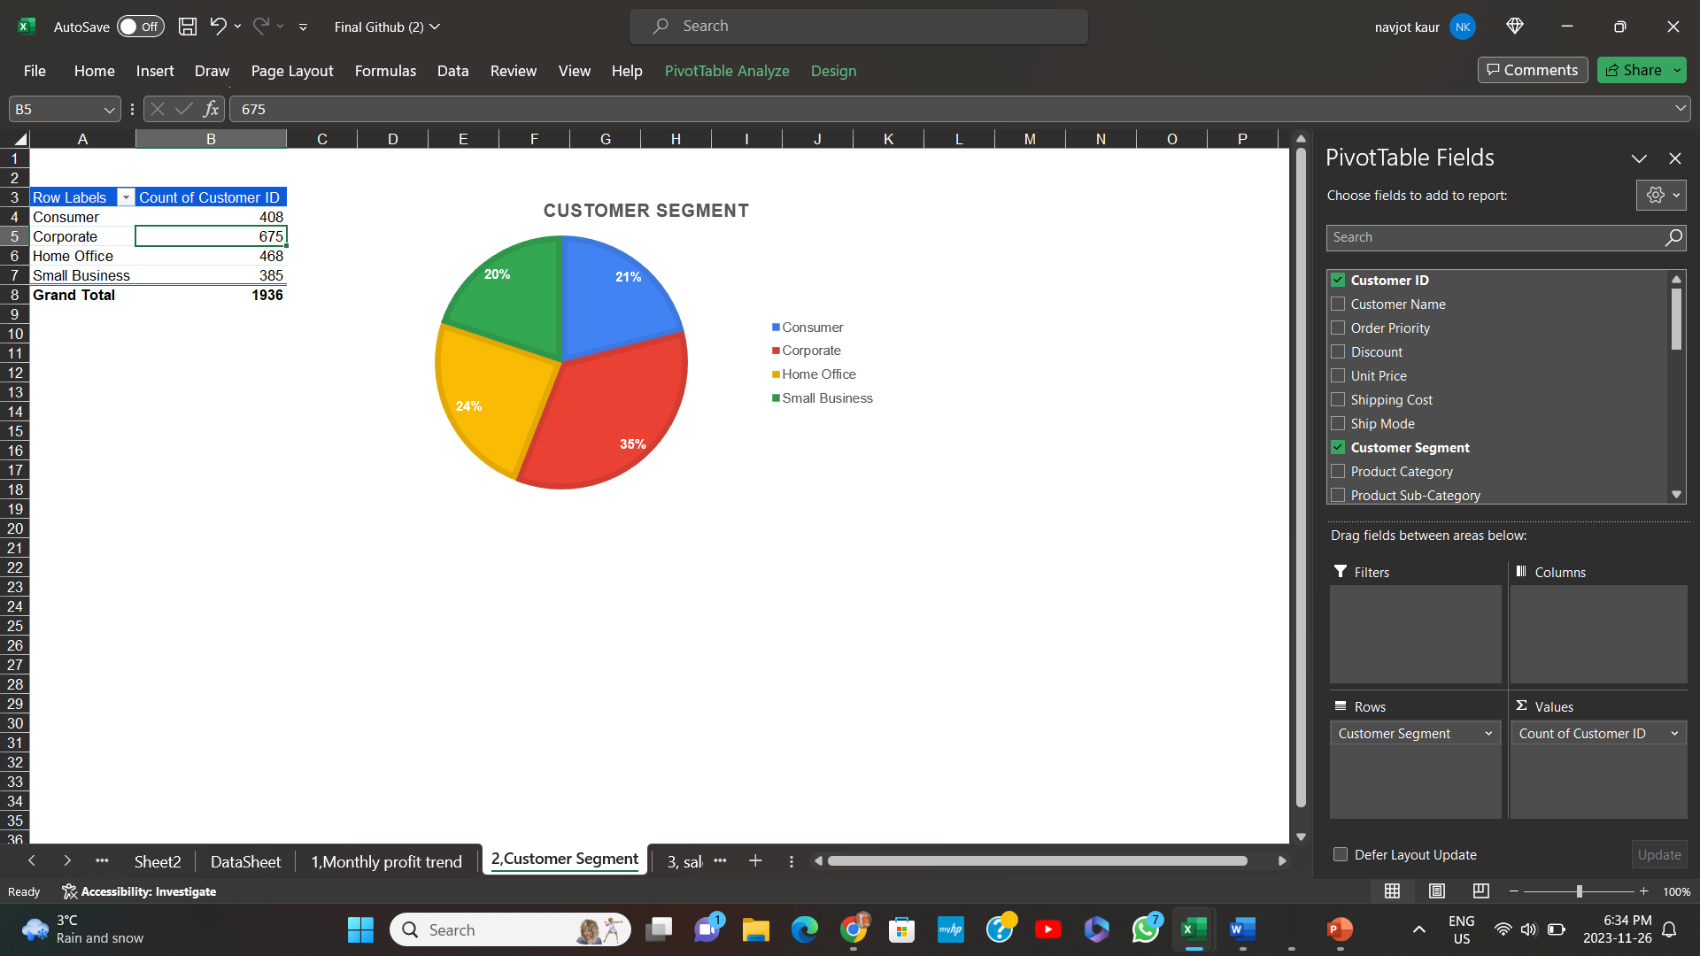
Customer segment

Slide 9
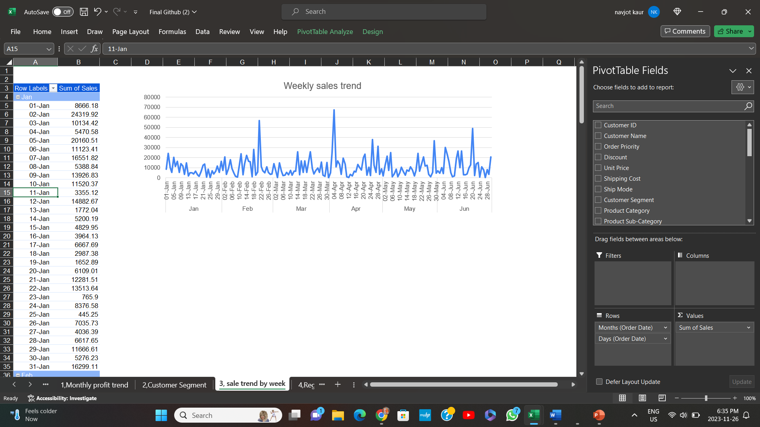
Sale trend by week

Slide 10
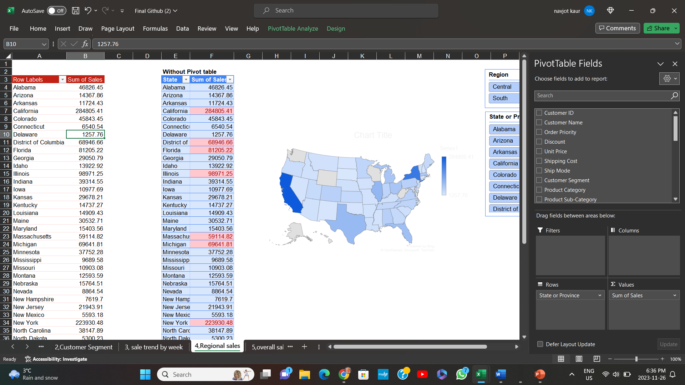
Regional sales

Slide 11
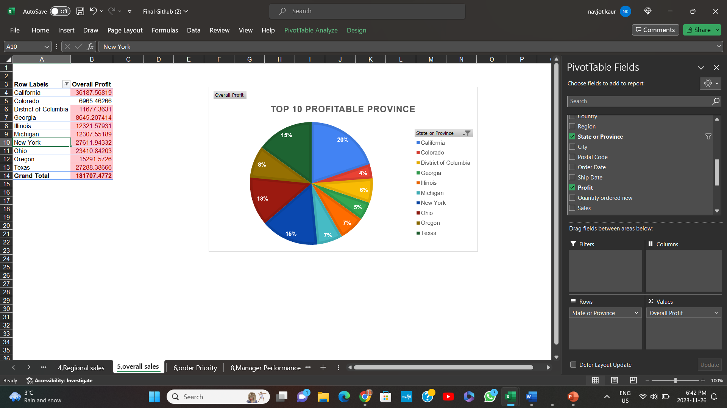
Overall sale

Slide 12
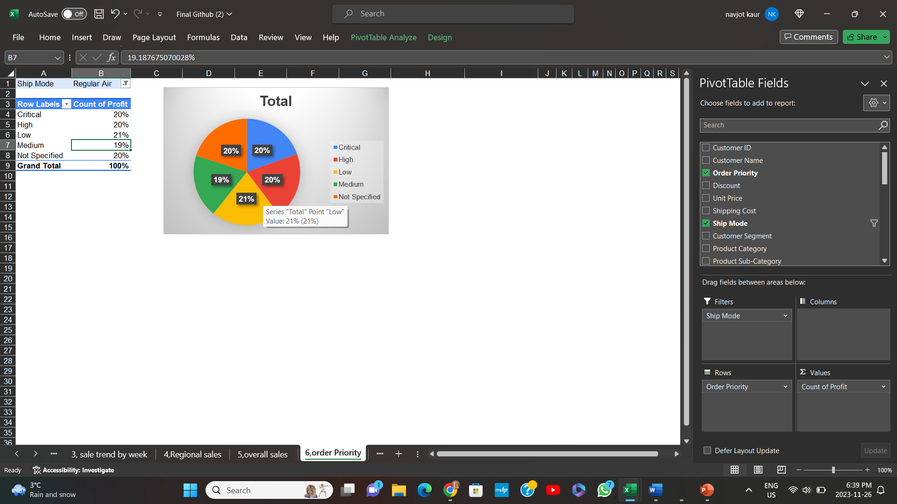
Order priority

Slide 13
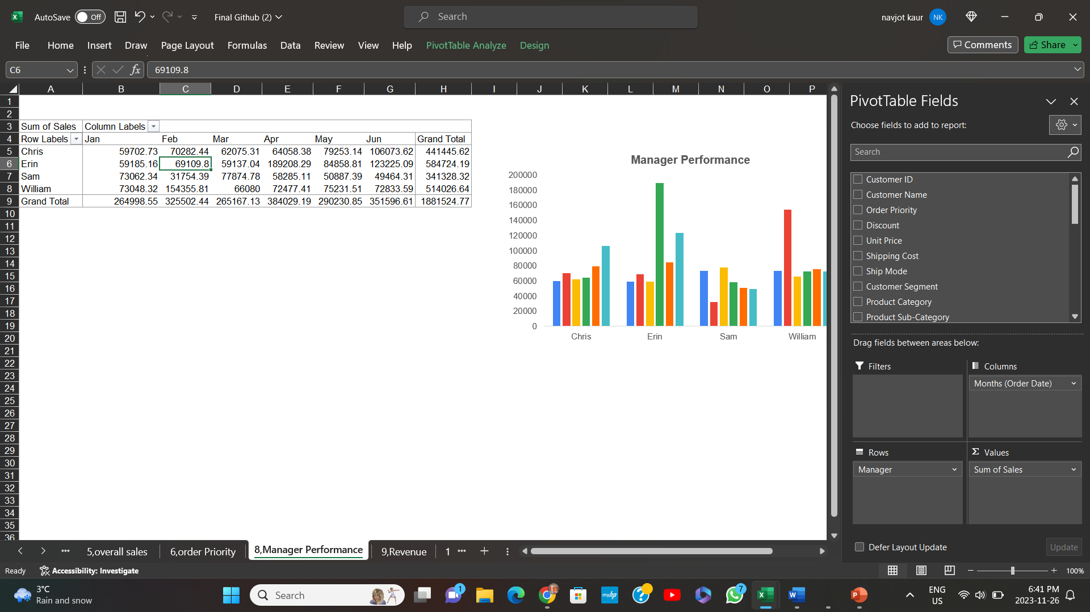
Manager performance

Slide 14
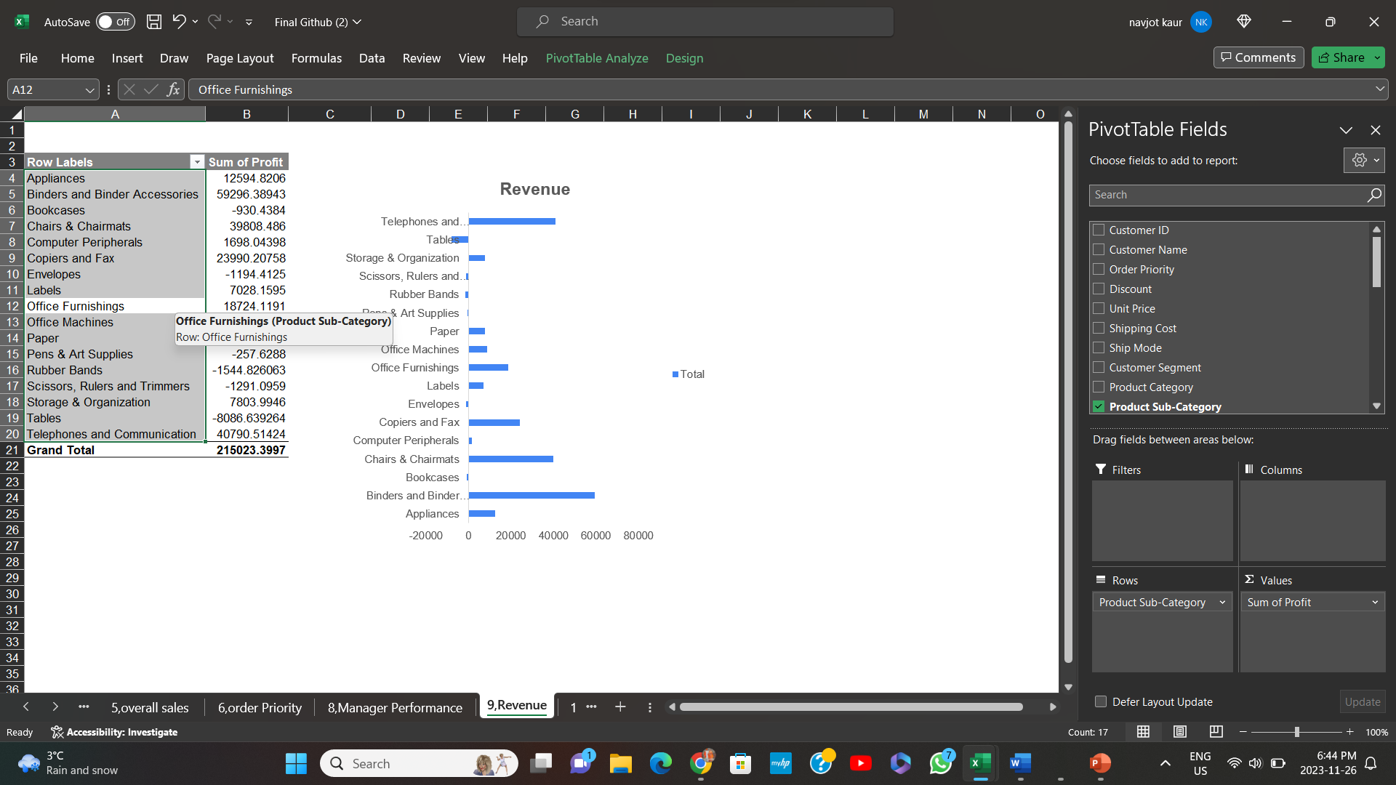
Revenue

Slide 15
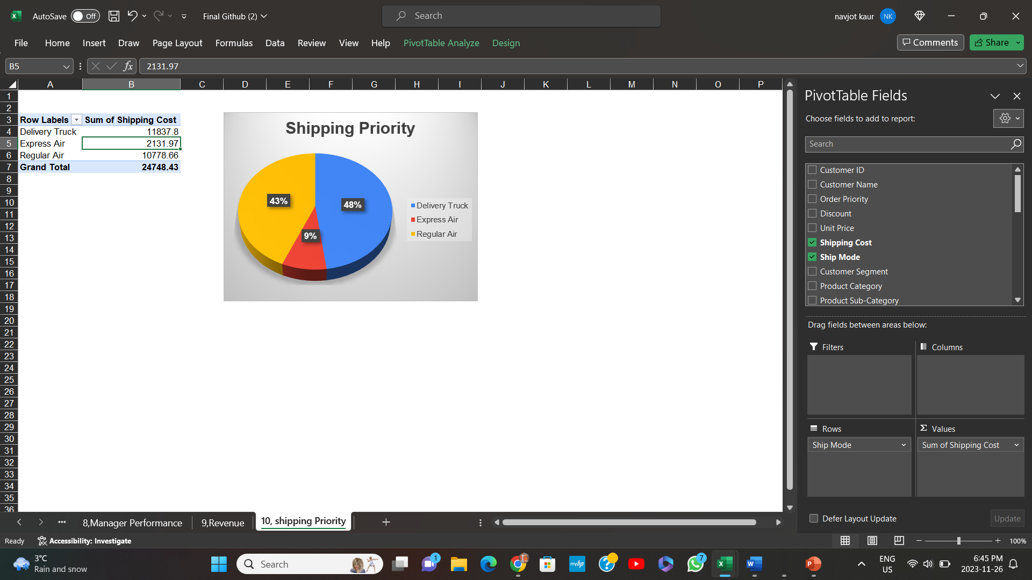
Shipping priority

Slide 16
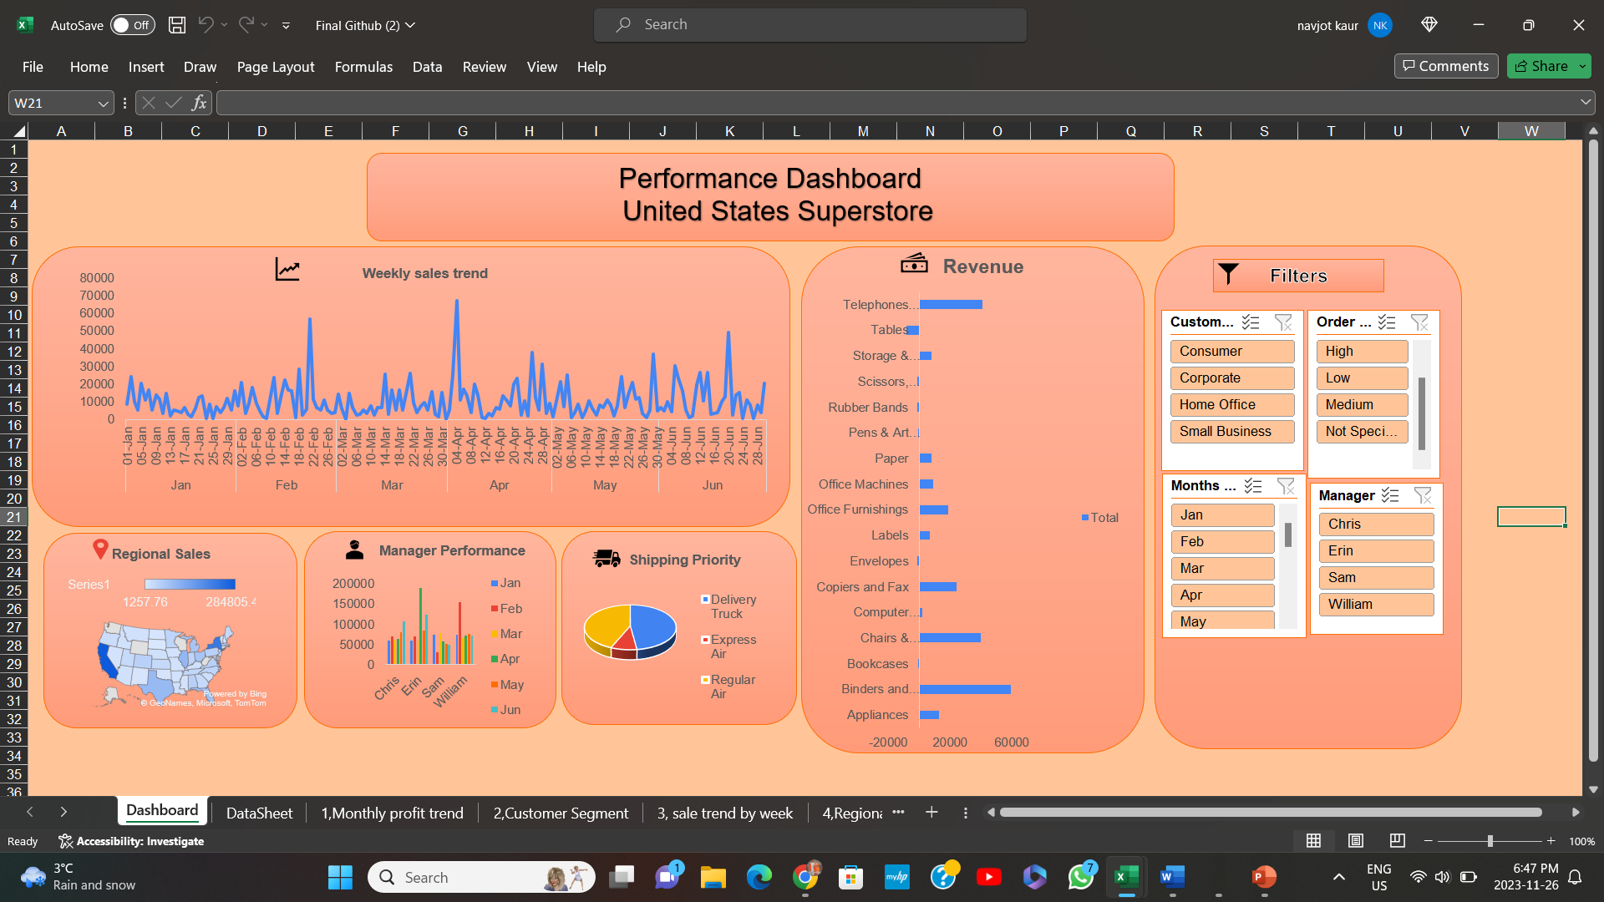
Performance Dashboard

